Slide 1
Machine Learning
Unsupervised Algorithms

Slide 2

Previous Day Recap
Duration - 2 minutes.
Interactive Discussion

Slide 3
Module Objectives
After completing this course you will be able to:
List different applications of unsupervised learning models
Understand how cluster analysis can be used
Explain what principal component analysis does and how it works
Distinguish the use cases for anomaly detection versus classification
Use all of these techniques in your applications

Slide 4
Cluster Analysis
Cluster analysis, or clustering, is the task of grouping a set of objects into clusters (groups), so that:
Objects in the same cluster are similar, and
Objects in different clusters are dissimilar
The concept of similarity is intentionally vague, as it depends on:
The chosen distance (as is the case for classification)
E.g., Euclidean, Manhattan, Hamming, …
The definition of cluster, determining the class of clustering algorithms:
Hierarchical, centroid-based, density-based, …
There is no objectively right algorithm:
What works in one kind of model, generally fails in another
The appropriate algorithm needs to be chosen experimentally

Slide 5
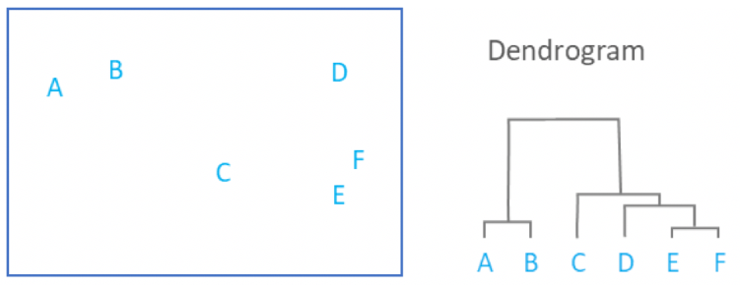
Hierarchical Clustering
Hierarchical clustering algorithms split the object space into a hierarchy of clusters
Any two distinct clusters will merge into a bigger cluster somewhere higher in the hierarchy
No single partition of the object space
The hierarchy can be represented by a dendrogram:
Notes:
A dendrogram is a tree-like diagram with nodes placed at different levels. Objects in the given object space are represented as leaf nodes and are on the bottom level. The closest common ancestor between any two leaf nodes represents the smallest cluster that contains the corresponding objects, and the height of this node is proportional to the distance between the objects. The root node represents the cluster that contains all the objects and is placed at the top of the hierarchy.

Slide 6
Hierarchical Clustering
Hierarchical clustering algorithms can be classified according to three main criteria:
Agglomerative clustering vs. divisive clustering
Agglomerative clustering builds the clusters from single elements (bottom-up)
Divisive clustering progressively splits the object space (top-down, rarely used)
The chosen distance between points:
Euclidean, Squared Euclidean, Manhattan, Maximum, …
The chosen distance between clusters (linkage):
Single-linkage clustering (the minimum distance)
Complete-linkage clustering (the maximum distance)
Average-linkage clustering (the average distance)
and many more (each leading to different cluster sets)
Notes:
Manhattan distance is the sum of the differences between coordinate pairs (it is like walking along city blocks towards your destination, hence the name). Maximum distance is the maximum difference between coordinates.
Divisive clustering is rarely used, due to its exponential time complexity ( O(2^(n-1)) ), which makes it unfeasible even for “non-big data”. Agglomerative clustering is also relatively complex in general ( O(n^3) ), although some algorithms can bring it down to O(n^2). For the sake of comparison, k-means takes linear time.

Slide 7
Hierarchical Clustering
Advantages
Yields reproducible results
Does not require prior knowledge of the number of clusters
Each level of the hierarchy gives a different partition that the user can choose
Disadvantages
Can’t handle big data well, due to quadratic (or higher) time complexity
Isn’t robust towards outliers, causing either
Chaining phenomenon (esp. with single-linkage), or
Lack of continuity (esp. with complete-linkage)
Density-based algorithms improve correctness of cluster identification
Minimum density requirements need to be satisfied by all clusters

Slide 8
Centroid-Based Clustering
Centroid-based clustering identifies clusters with a central vector called centroid
A vector is then assigned to the cluster of the closest centroid
The centroid does not have to be a member of the cluster
K-means clustering is the most prominent sub-class of centroid-based clustering
The difference from the general class is that the number of clusters k is fixed
K-means clustering tries to solve the following optimization problem:
Find k centroids and assign each point to a centroid,
so that intra-cluster variance is minimized.
The problem is NP-hard
Most algorithms give approximate solutions
Notes:
Intra-cluster variance is the sum of squared distances between a point and its centroid.

Slide 9
K-Means Clustering Algorithm
Lloyd's algorithm is one common implementation of k-means clustering:
INPUT: number of clusters, k; set of points x₁,…,x_{n}
Place centroids c₁,…,c_{k} at random locations
Repeat until convergence:
For each point x_{i}:
Find nearest centroid c_{j}
Assign point x_{i} to cluster Cl_{j}
For each jϵ{1,…,k}:
Recompute centroid c_{j} as mean of all points in Cl_{j}
Linear time complexity:
O(#iterations * #clusters * #instances * #dimensions)
Notes:
NOTES
- Line 4: the distance used in selecting the closest centroid to a point is arbitrary; this gives rise to different algorithms (Euclidean distance is a common choice)
- Line 7: To compute a centroid, we use the geometric mean; that is, we take the average of each coordinate of all the points in the cluster.
=> that means only numerical attributes are allowed (no categorical attributes)

Slide 10
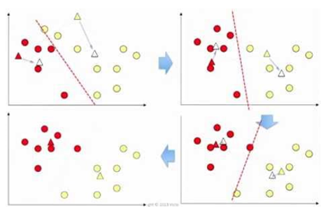
K-Means Clustering Algorithm
Graphical illustration

Slide 11
Exercise 1
Does the k-means clustering algorithm shown guarantee optimality?
Duration - 15 minutes.
Interactive discussion.
Notes:
The answer to the question is no, only convergence to a local optimum can be guaranteed.

Slide 12
K-Means Clustering
Variants of the k-means algorithm include:
Choosing the best of multiple runs, by varying
The value of k, and/or
The initial locations of the centroids
K-Medoids
Restricts centroids to members of the dataset
K-Medians
Chooses medians when recomputing centroids
K-Means++
Chooses the initial centers less randomly
Soft K-Means (or Fuzzy C-Means)
Allows data points to be in more than one cluster
Notes:
Example of a sub-optimal clustering by k-means and motivation for k-means++ (from Wikipedia):
“To illustrate the potential of the k-means algorithm to perform arbitrarily poorly with respect to the objective function of minimizing the sum of squared distances of cluster points to the centroid of their assigned clusters, consider the example of four points in R² that form an axis-aligned rectangle whose width is greater than its height.
If k = 2 and the two initial cluster centers lie at the midpoints of the top and bottom line segments of the rectangle formed by the four data points, the k-means algorithm converges immediately, without moving these cluster centers. Consequently, the two bottom data points are clustered together and the two data points forming the top of the rectangle are clustered together—a suboptimal clustering because the width of the rectangle is greater than its height.
Now, consider stretching the rectangle horizontally to an arbitrary width. The standard k-means algorithm will continue to cluster the points sub-optimally, and by increasing the horizontal distance between the two data points in each cluster, we can make the algorithm perform arbitrarily poorly with respect to the k-means objective function.”

Slide 13
K-Means Clustering in Python
Import packages and classes:
Create model and fit it:
Get results:
from sklearn.cluster import KMeans
kmeans = KMeans(n_clusters=4, init=‘k-means++’,
max_iter=300, n_init=10, random_state=0)
kmeans.fit(x_train)
y_pred = kmeans.fit_predict(x_train)
y_pred = kmeans.predict(x_test)
kmeans.inertia_
kmeans.cluster_centers_
Notes:
The n_init parameter indicates the number of times the k-means algorithm will be run with different centroid seeds. The final result will be the best output of the n_init runs, in terms of inertia.
The max_iter parameter indicates the maximum number of iterations of the k-means algorithm for a single run.
The random_state parameter determines random number generation for centroid initialization. Use an int to make randomness deterministic. Additional info on random number generation and its seed can be found here:
https://www.statisticshowto.datasciencecentral.com/random-seed-definition/
The inertia_ attribute is the sum of squared distances of samples to the closest cluster center.
The cluster_centers_ is the array of coordinates of cluster centers.
The fit_predict method computes the cluster centers and predicts the cluster index for each sample.
More info on the KMeans package, here:
https://scikit-learn.org/stable/modules/generated/sklearn.cluster.KMeans.html
Two tutorials on how to use them:
https://towardsdatascience.com/machine-learning-algorithms-part-9-k-means-example-in-python-f2ad05ed5203
https://www.datacamp.com/community/tutorials/k-means-clustering-python

Slide 14
K-Means Clustering
Advantages
Fast, compared to other approaches
This point alone makes it very popular, particularly for big data
Works well with globular clusters (hyper-spherical objects) of similar sizes
Disadvantages
Value of k must be set from the start
To get an idea of the best k, multiple runs are required
Incorrectly identifies clusters of varying sizes and shapes
Random initial selection of centroids leads to results that are:
irreproducible
counter-intuitive (sometimes)
K-means++ improves optimality
Notes:
The reason why K-means incorrectly identifies clusters which have varying sizes and shapes is because it partitions the space into regions of similar sizes. From Wikipedia:
“When for example applying k-means with a value of k=3 onto the well-known Iris flower data set, the result often fails to separate the three Iris species contained in the data set. With k=2, the two visible clusters (one containing two species) will be discovered, whereas with k=3 one of the two clusters will be split into two even parts. In fact, k=2 is more appropriate for this data set, despite the data set's containing 3 classes”.

Slide 15
Clustering
Applications
Recommender systems (grouping customers / clients / items / ...)
Marketing (market segmentation to improve targeting and positioning)
Finance (clustering stocks into sectors to improve analysis)
Social network analysis (recognizing communities within large groups of people)
Crime analysis (identifying areas with higher crime rates)
Evolutionary algorithms (identifying niches to even reproductive chances)
Image segmentation (e.g. medical imaging)

Slide 16
Principal Component Analysis
Principal Component Analysis is a feature projection technique used in dimensionality reduction
Feature projection is similar to feature selection
Feature selection keeps the most relevant features as they are and discards the others
Feature projection transforms the original feature space into a lower-dimensional space
PCA applies a linear transformation to the feature space, where:
Coordinates in the transformed space are known as principal components
The first principal component exhibits the greatest variance
The second one exhibits the second greatest variance, and so on
Principal components of low variance are omitted

Slide 17
A Brief Recap of Linear Algebraic Notions
A grasp of linear algebra helps to understand PCA. Let us recall some key notions:
A linear transformation maps a vector space into another, preserving addition and scalar multiplication
Geometrically, it keeps the origin fixed and does not bend straight lines (vectors)
Vectors may at most be stretched and/or rotated
An eigenvector for a linear transformation is a vector that is not rotated by it
It comes with an eigenvalue which is its stretching factor
Linear transformations are commonly represented as matrices
The transpose X^{T} of a matrix X is obtained by flipping it
Columns become rows and rows become columns
We leave product of matrices to lookup as an exercise
Notes:
Note that "stretching" of straight lines also includes reflection and squishing. For example, a linear transformation applied to one of its eigenvectors may:
Stretch it (when the corresponding eigenvalue is greater than one);
Leave it unchanged (when the eigenvalue is one);
Squish it (when the eigenvalue is positive but less than one);
Reverse it (when the eigenvalue is negative).

Slide 18
Principal Component Analysis
Before we introduce the PCA algorithm, note the following:
If we take the matrix representation X for the training data, it turns out that:
The maximum eigenvalue of the covariance matrix X^{T}X equals X's maximum variance
The associated eigenvector corresponds to the axis of measurement for such variance
If we remove this eigenvector, we can find the next largest eigenvalue in the same way
Its eigenvector happens to be orthogonal to the first
If we iterate this process, we can find an orthogonal basis of eigenvectors, where:
The first eigenvector has the largest eigenvalue
The second eigenvector has the second largest eigenvalue, and so on
If we select only the first k eigenvectors, we have a projection where:
Variance is maximized (exactly as we wanted)
Notes:
NOTE: For the above considerations to hold:
The training dataset should be centered, so that its geometric mean is on the origin;
The search for the maximum eigenvalue is performed on the condition that the corresponding eigenvector is a unit vector (i.e., the product between its transpose and the vector itself is one).

Slide 19
Principal Component Analysis
An algorithm for PCA can be sketched out as follows:
INPUT: Matrix X of training data
Calculate empirical mean vector u of X's rows
Calculate deviation matrix B of X's rows from the mean vector u
Calculate the covariance matrix C of B
Calculate eigenvectors and eigenvalues of C as described
Project X onto the k eigenvectors with highest eigenvalue
Notes:
NOTES:
Line 2 corresponds to centering X around the mean.
In practice, an alternative algorithm using the correlation matrix instead of the covariance matrix is preferred, due to its lower time complexity

Slide 20
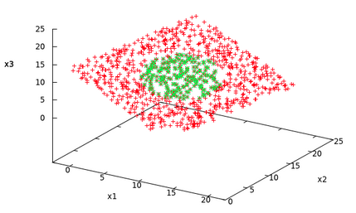
Principal Component Analysis
PCA performs best when we can lower the number of dimensions while keeping high variance
Here is a graphical illustration of how this works:
Original 3D distribution

Slide 21
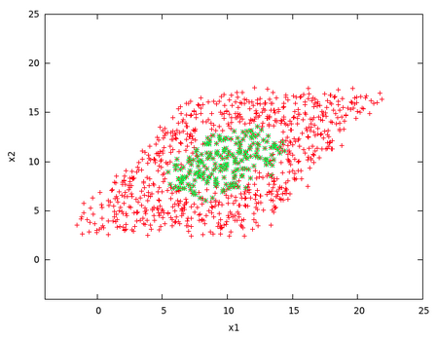
Principal Component Analysis
PCA performs best when we can lower the number of dimensions while keeping high variance
Here is a graphical illustration of how this works:
Feature Selection
(projects on x₁ and x₂)
Original 3D distribution
Not bad… but skewed

Slide 22
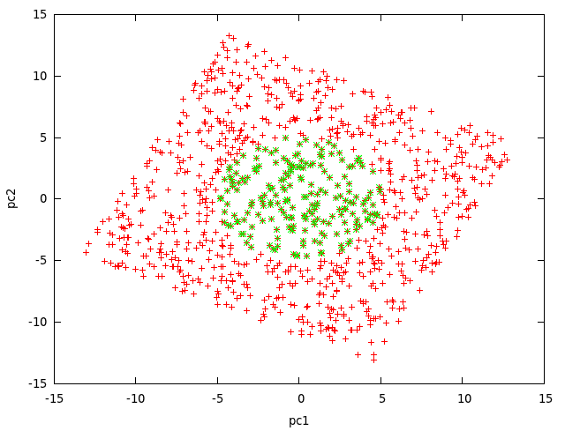
Principal Component Analysis
PCA performs best when we can lower the number of dimensions while keeping high variance
Here is a graphical illustration of how this works:
Principal Components Analysis
(projects on principal components)
Original 3D distribution
Perpendicular view
Variance is maximized

Slide 23
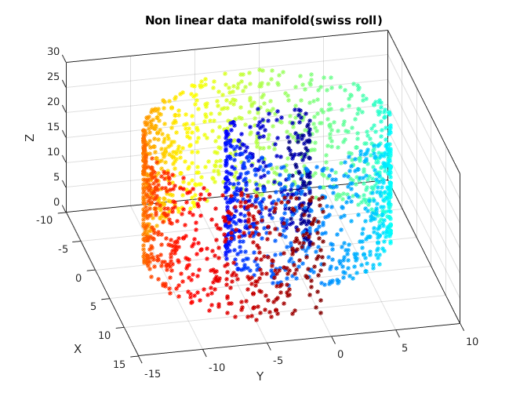
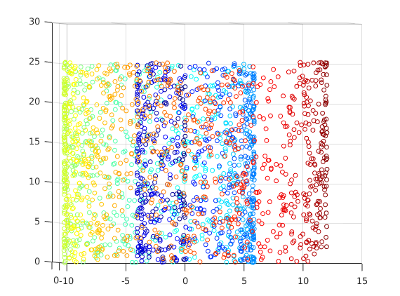
Principal Component Analysis
PCA doesn't always work as we wish it to:
Can you guess what the problem is?
Notes:
It is a combination of two issues:
All three dimensions offer relatively high levels of variance
The (linear) projection on the first and second principal components cancels the (non-linear) shape that can be seen in the second and third principal components.
Because of the above two points, a projection on the second and third principal components would give better results in this case.
PCA is more useful when datasets have very high dimensionality. Luckily, it is unlikely that all dimensions have high levels of variance in such cases, and instances of the above problem are much harder to occur. The values in the remaining dimensions, therefore, tend to be small and may be dropped with minimal loss of information. Nonetheless, a careful analysis of the number of dimensions over which to project is advisable.

Slide 24
Principal Component Analysis in Python
Import packages and classes:
Create model with given number of components and get results:
Create model with given retained variance and get results:
from sklearn.decomposition import PCA
pca = PCA(n_components=2)
principal_components = pca.fit_transform(x_train)
pca.explained_variance_ratio_
pca = PCA(.95)
pca.fit(x_train)
pca.n_components_
x_img = pca.transform(x)
Notes:
The explained_variance_ratio_ attribute provides you with the amount of information (or, variance) each component holds after projecting the data to a lower dimensional subspace.
The fit method fits the model with the data it receives as input.
The fit_transform method fits the model with the input data and returns the data after applying dimensionality reduction to it.
More info on the PCA package, here:
https://scikit-learn.org/stable/modules/generated/sklearn.decomposition.PCA.html#sklearn.decomposition.PCA.fit
Two tutorials on how to use them:
https://towardsdatascience.com/pca-using-python-scikit-learn-e653f8989e60
https://www.datacamp.com/community/tutorials/principal-component-analysis-in-python

Slide 25
Principal Component Analysis
Advantages
Reduces computational cost by removing redundant/irrelevant features
Allows to spot clusters that would be too spread out in high dimensions
Reduces chances of overfitting in regression analysis over many dimensions
Can reduce noise (due to better signal-to-noise ratio in first few principal components)
Disadvantages
Is sensitive to the scaling of the variables
Yields arbitrary results when variables have different units of measure
Scaling to unit variance fixes the issue but compresses all dimensions
Isn't optimized for class separation (in pattern recognition applications)
Fails if all dimensions are relevant and linearity is violated (as shown)
Notes:
On the units of measure issue: consider plotting temperature against mass; the data distribution varies greatly based on the choice of the unit (Celsius vs. Farheneit); this would in turn affect the outcome of the analysis. From Wikipedia:
"Pearson's original paper was entitled "On Lines and Planes of Closest Fit to Systems of Points in Space" – "in space" implies physical Euclidean space where such concerns do not arise. One way of making the PCA less arbitrary is to use variables scaled so as to have unit variance, by standardizing the data and hence use the autocorrelation matrix instead of the autocovariance matrix as a basis for PCA. However, this compresses (or expands) the fluctuations in all dimensions of the signal space to unit variance."

Slide 26
Principal Component Analysis
Applications
Quantitative finance (managing risk of portfolios; enhancing return of portfolios)
Stock rating
Recommendation engines
Neuroscience
Speech recognition
Image and text processing

Slide 27
Anomaly Detection
Anomaly Detection is the identification of rare observations that raise suspicion
Used in data preparation to identify outliers that need to be filtered off
Typically unsupervised or semi-supervised:
Semi-supervised = unsupervised training with supervised validation and testing
The highly unbalanced nature of anomaly detection is its most distinctive feature
In classification, the training set is evenly split between positives and negatives
In clustering, all clusters are typically sizable
Anomalies are unique, by definition
Different kinds of algorithms apply

Slide 28
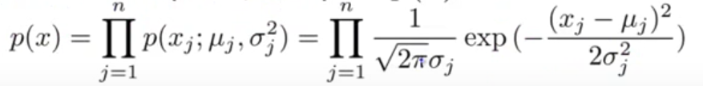
Anomaly Detection
An algorithm for anomaly detection can be sketched out as follows:
INPUT: Normally distributed training set of m observations
Choose n independent features
Set lower probability bound ε
For each feature i, compute mean μ_{i} and variance σ_{i}²
On unseen observation x, calculate probability:
Flag anomaly when p(x)< ε
Notes:
NOTE: Sometimes features are not independent. In that case, a variant of the above algorithm applies, taking into account the variance as well as the covariance (i.e. using the covariance matrix).

Slide 29
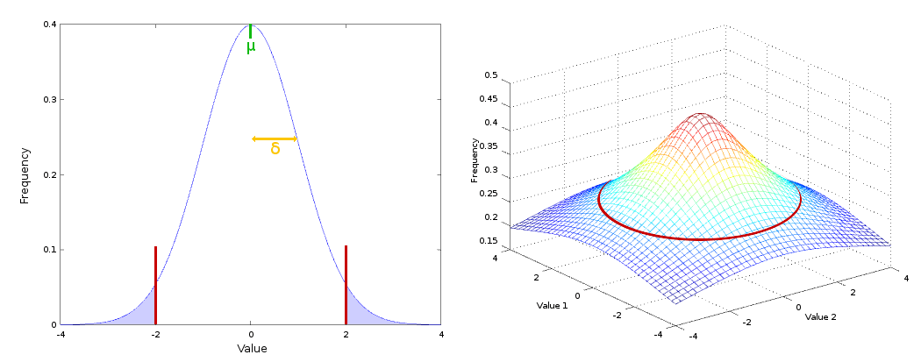
Anomaly Detection
Threshold ε separates regions of high and low probability
Here are two examples, in 1 and 2 dimensions respectively:

Slide 30
Anomaly Detection
The performance of the model rests on the choice of:
independent features
algorithm (e.g. if features are not independent, a different algorithm applies)
threshold ε
Human supervision may help to optimize these choices through validation and testing:
Training set with few or no anomalies (unsupervised learning)
Validation and test sets each with a small number of anomalies (e.g. 0.5%)
Validation and test data must be labelled for anomalies to be flagged
Model's outcome to be compared with label for evaluation
Possible evaluation metrics include:
Analysis of true/false positives/negatives
Precision / recall, F₁-score, ...

Slide 31
Anomaly Detection in Python
There are many different packages and techniques to choose from: here, we use isolation forest.
Import packages and classes:
Create model and fit it:
Get results:
from sklearn.ensemble import IsolationForest
clf = IsolationForest(max_samples=100, random_state=1, contamination= ‘auto’)
clf.fit(x_train)
y_pred = clf.predict(x_test)
y_pred = clf.fit_predict(x)
anomaly_scores = clf.decision_function(x_test)
Notes:
There are many different packages and techniques to perform anomaly detection (more references below). Above we show how to use IsolationForest from the sklearn.ensemble package, as an example.
The contamination parameter indicates the proportion of outliers in the dataset. If ‘auto’, the decision function threshold is determined as in the original paper (Liu, Fei Tony, Ting, Kai Ming and Zhou, Zhi-Hua. “Isolation forest.” Data Mining, 2008. ICDM‘08).
The decision_function method returns the array of average anomaly scores on x_train of the trees in the forest. The lower the score, the more abnormal the sample. Negative scores represent outliers, positive scores represent inliers.
More info on the IsolationForest package, here:
https://scikit-learn.org/stable/modules/generated/sklearn.ensemble.IsolationForest.html#sklearn.ensemble.IsolationForest
Tutorial and info on various techniques from the sklearn library:
https://scikit-learn.org/stable/auto_examples/plot_anomaly_comparison.html
https://scikit-learn.org/stable/modules/outlier_detection.html
Two additional tutorials showing different techniques (including with user-defined algorithms):
https://towardsdatascience.com/5-ways-to-detect-outliers-that-every-data-scientist-should-know-python-code-70a54335a623
https://towardsdatascience.com/andrew-ngs-machine-learning-course-in-python-anomaly-detection-1233d23dba95

Slide 32
Anomaly Detection vs. Classification
Anomaly Detection
Very small number of positive examples (i.e. examples of anomalies)
Large number of negative examples (i.e. "normal observations")
Many different "types" of anomalies
Hard for algorithm to learn from positive examples what anomalies look like
Classification
Large number of positive and negative examples
Enough for algorithm to learn what positives and negatives look like
Future positives / negatives likely to be similar to those in training set

Slide 33
Anomaly Detection vs. Classification: Applications
Anomaly Detection
Fraud detection
Fault detection in manufacturing (e.g. detecting faulty aircraft engines)
System health monitoring (e.g. monitoring machines in a data center)
Intrusion detection
Event detection in sensor networks
Detecting ecosystem disturbances
Classification
Email spam classification
Weather forecasting
Cancer classification
Notes:
NOTES:
Spam is frequent enough to be suitable for classification techniques
Major online retailers may have enough examples of fraud to apply classification algorithms to the fraud detection problem as well
Similar considerations apply to some manufacturing processes, monitoring machines in data center, etc...

Slide 34
Module Review
How can a cluster be defined and what variables does it depend on?
List and compare two main approaches to clustering
How are centroids computed in each iteration of K-Means clustering?
What is a principal component?
When is PCA useful and when can it be misleading?
Is anomaly detection supervised or unsupervised? Elaborate

Slide 35
Module Outcomes
You should be able to:
Explain how clustering can simplify analysis
Compare hierarchical versus centroid-based clustering
Describe what principal component analysis does
Understand how anomaly detection works
Compare and distinguish the two problems of anomaly detection and classification

Slide 36
Questions

